Slide 1
Health and Social Care Cambridge Technicals Knowledge Organiser
Unit 4
LO4: The musculoskeletal system, malfunctions and their impact on individuals.

Slide 2
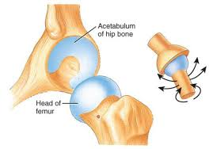
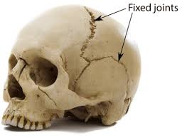
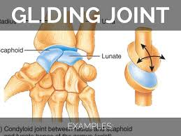
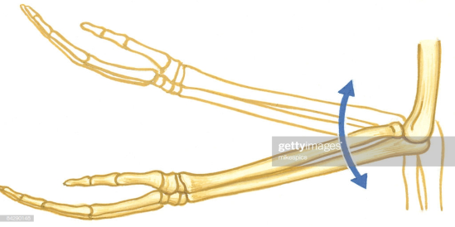
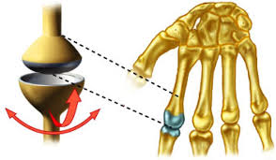
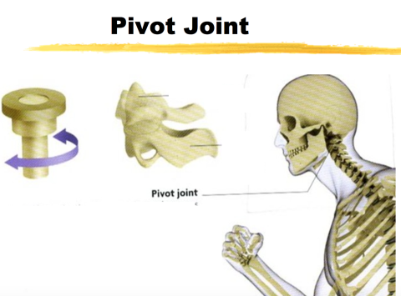
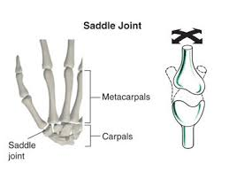
Structure of bone:
Types of Joint:
The diagram shows a vertical cross section of the femur.
There are different types of joint, you will need to know what they are and where they are found in the body.
Type of joint | Where is it found?
Ball and socket | Hip and shoulder
Pivot | Neck
Hinge | Elbow and knee
Sliding/gliding | Wrist and ankle
Fixed | Cranium and pelvis
Candyloid | Knuckles
Saddle | Base of fingers
Ball and socket
Blood vessels
Exam Tip!
You will need to make sure that you learn the names of the vertical section and transverse section and be able to label diagrams.
Make sure you know the correct names of the joints and be able to give an example of where they are found in the body.
Transverse section of the femur
Hinge joint
Candyloid joint

Slide 3
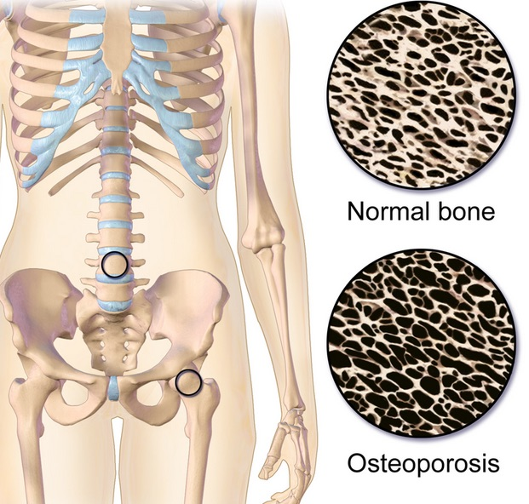
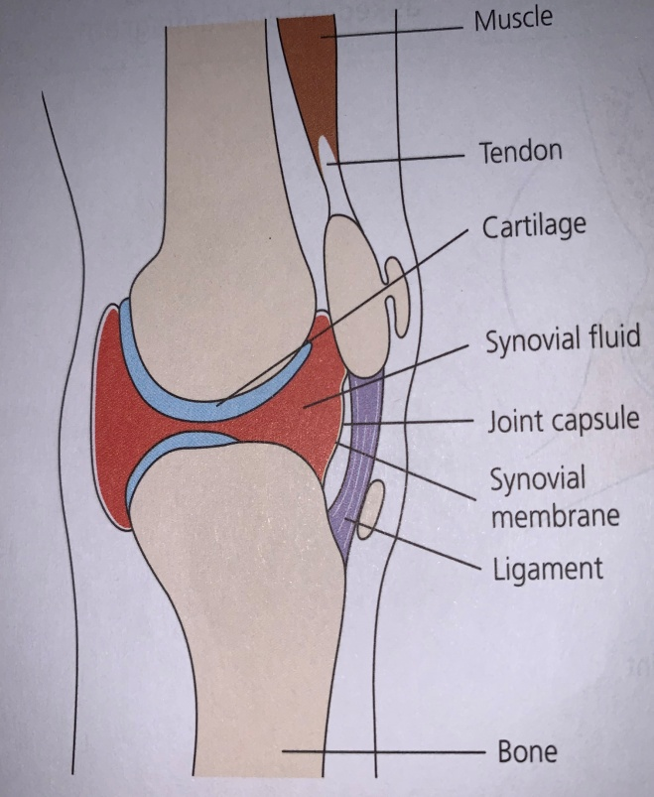
Synovial joint components
Musculoskeletal malfunctions: possible causes and effects on individuals.
Muscle – necessary for movement, it contracts and relaxes to move the joint.
Bone – provides the framework and support for the attachment of muscle and other tissues.
Ligament – attached one bone to another bone.
Tendon – attaches a muscle to a bone.
Cartilage – reduces friction and absorbs shock in the joint which allows the joint to move smoothly.
Synovial capsule – secretes synovial fluid and maintains joint stability.
Synovial fluid- lubricates and nourishes the joint.
Osteoporosis is a disease that is characterised by low bone mass and deterioration of the bone tissue. It makes bones more fragile, leading to fracturing more easily. Bone density scans are carried out to asses and monitor the progress of the disease.
Symptoms:
Often not detected until a minor fall or an impact causes a fracture.
Most common fractures are wrists, hip and vertebrae (spinal bones)
In severe cases a cough or sneeze can cause a rib fracture or partial collapse of a vertebrae – this can lead to curvature of the spine and height loss.
Muscle action around the joint:
Muscles have to work in pairs to make opposite actions happen, as they can only ‘pull’ when they contract. They cannot ‘push’.
Antagonistic pairs of muscles create movement as one contracts the other (antagonist) relaxes.
Examples:
Quadriceps and hamstrings in the legs and the biceps and triceps in the arms.
When a muscle contracts to move a joint – the tendon pulls on the bone.
Biological explanation:
Due to the loss of the protein matrix resulting in a loss of bone density – this weakens the bones and they become brittle.
Bones naturally become thinner with age – particularly women, who lose bone density rapidly after menopause( first couple of years).
This is as a result of the decline in the hormone oestrogen after menopause. (Oestrogen promotes bone formation)
Cause:
Losing bone density is normal in the aging process, however, in some cases this can lead to osteoporosis.
Risk factors include; family history of the condition or hip fractures, heaving smoking and drinking, eating disorders such as bulimia and anorexia, long-term use of some medications (typically treatment for breast and prostate cancer or corticosteroids used to treat arthritis and asthma).
Other conditions can increase the risk of developing osteoporosis , including; Chrohn’s disease, rheumatoid arthritis, overactive thyroid gland and COPD.
Women are at a greater risk, particularly if they have early onset menopause, a hysterectomy or over-exercising related issues with absent periods or too much dieting.
Bone health can also be affected by lifestyle choices such as diet and exercise.
The knee is a synovial joint.

Slide 4
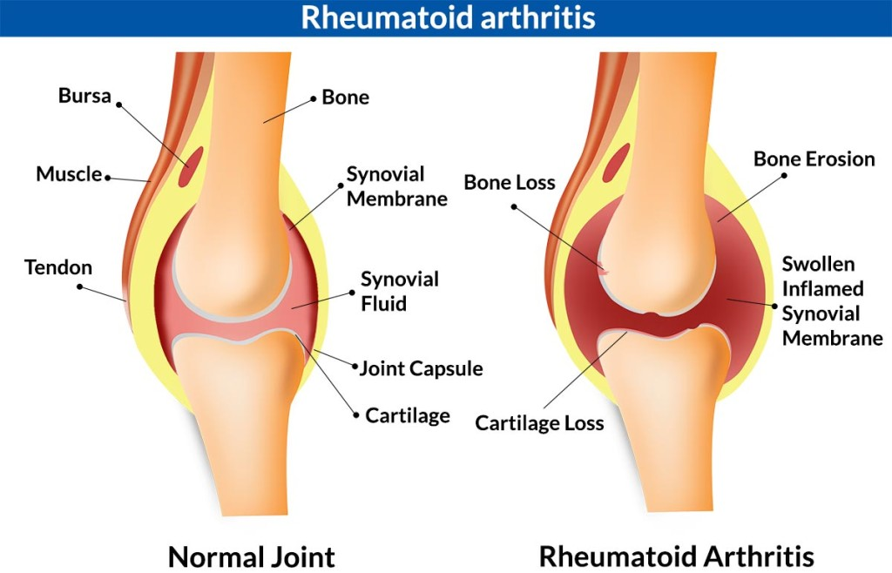
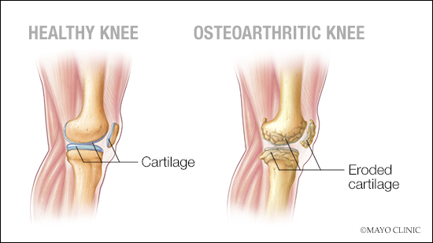
Osteoarthritis:
Musculoskeletal malfunctions: possible causes and effects on individuals.
Symptoms:
Joints become stiff and painful.
Joints most commonly affected are hips, knees and small joints in the hands.
Individuals can suffer from tenderness in the joint and if it is not moved for a while there is increased pain.
There can be an audible grating or cracking noise and or sensation when moving the joint.
Restriction in movement of the affected joint and a more ‘knobbly’ appearance.
Biological explanation:
General wear and tear is usually repaired by the body without us noticing, with osteoarthritis, the cartilage can be lost and bony growths develop and that area becomes inflamed.
Cartilage is firm and rubbery and works as a shock absorber allowing the joints to move smoothly – with osteoarthritis, the cartilage becomes stiff and loses elasticity over time.
As the cartilage deteriorates, the tendons and ligaments stretch and cause the bones to rub against each other causing pain.
Causes:
Sometimes known as wear and tear arthritis – it is not a normal part of aging. Risk of developing the condition dies increase as a person ages and it can run in a family.
If a person is overweight, it puts excess strain on the weight-bearing joints – so can be worse for them.
Can develop joint damage from a previous injury or operation. It is has not been given enough time to heal after an operation or injury, osteoarthritis can occur later in life.
Symptoms:
Can vary and they may come and go and change over time.
Joints can swell, become hot and tender to touch as well as being stiff, aching and throbbing with pain.
Rheumatoid nodules can develop which are firm swellings that develop under the skin around affected joints.
Biological explanation:
The immune system mistakenly attacks the cells that line the joints and the synovial membrane that lines and lubricates the joint becomes sore and inflamed.
The joint becomes misshapen and rigid as scar tissue replaces the cartilage.
Cause:
Cause of rheumatoid arthritis is not known – one theory states it is an infection or virus that triggers the condition – this causes an autoimmune response where the body attacks its own tissues in the surrounding joint.
Some evidence that the condition may be increase by heavy smoking and by hormones = more common in women due to higher levels of oestrogen.
There is a possibility that it runs in a family as an inherited trait – although this is a low risk as genes play such a small role in the condition.

Slide 5
Musculoskeletal malfunctions: monitoring, treatment and care needs.
Impacts on lifestyle of musculoskeletal malfunctions:
Arthritis:
Medication:
Steroids and NSAIDs (non-steroidal anti-inflammatory drugs) to reduce swelling and joint inflammation.
Pain killers , such as paracetamol.
Corticosteroid injections into the joint to reduce swelling.
Glucosamine and chondroitin supplements to relieve symptoms.
Physiotherapy and exercise:
Joint manipulation like physiotherapy, to strengthen muscles around joints and keep them as flexible to maintain as much mobility as possible.
Mobility assistance equipment like walking sticks to take the weight off the joint, or a splint to support a joint.
Pain relief in the form of a TENS device, which gives electrical impulses and can reduce pain.
Surgery:
Arthroscopy – clean out the debris in the joint.
Arthroplasty – joint replacement – knee or hip replacement to renew an affected joint.
Osteotomy – a bone is cut and re-aligned.
Appropriate treatment and changes in lifestyle can help individuals stay mobile and active by managing their symptoms and minimising the effects of their condition – enabling them to work and live a full and active life.
Medication – can have side effects.
Attending regular appointments and check ups to monitor the condition.
Dietary changes and healthy eating.
Being physically active – regular exercise.
Taking care not to cause fractures – have to consider; hobbies, lifting, gardening, ability to exercise etc.
Height loss – leads to back pain and curvature of the spine (hunched appearance).
Lack of sleep resulting in tiredness, lack of concentration and emotional and social effects coping with the pain.
Could become immobile and housebound or need a single story home.
May need to use a wheelchair, walking sticks or walking frame.
Recovery from surgery.
Adaptations to the home – stair-lift, hand rails, bath chair, grab handles, lever taps (makes them easier to turn).
Can make preparing meals, shopping, driving etc. more difficult or impossible.
Osteoperosis:
Monitoring methods:
DEXA scan – bone density scan.
Blood tests.
Possible Treatments:
Supplements – Vitamin D and Calcium.
Doing load-bearing exercises.
HRT (hormone-replacement therapy) = oestrogen /progesterone prescribed for post-menopausal women.
Taking biphosphonates – slow the rate at which the bone is broken down in the body – trying to maintain bone density and reduce the risk of fractures. (Can be injection or tablet form and can have side effects.
Medication for strengthening bones.
Physiotherapy and TENs machine.
Exam Tips:
Be able to identify the parts of the synovial joint and their functions.
Ensure you know the difference between Osteoarthritis and Rheumatoid Arthritis – don’t mix them up!
Be able to give examples of monitoring methods and treatments for musculoskeletal conditions.
Don’t just say a condition is caused by being over-weight, you have to qualify it – i.e. Putting more strain on the joint causing damage etc.
Revision ideas:
Try drawing and labelling the different diagrams yourself.
Create cue cards with symptoms, monitoring, treatments and impacts on lifestyle etc.

